Slide 1
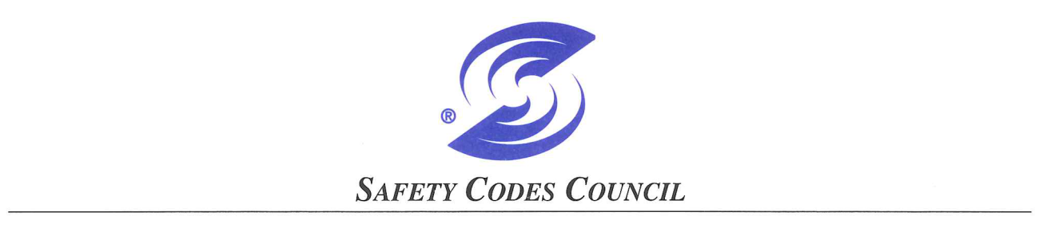
May 26, 2015 Update
Agenda
Safety Moment
What is the Boiler and Pressure Vessel Technical Sub-Council?
2014/15 Business

Slide 2
May 26, 2015 Update
Agenda
Power Engineers Updates
ASME/CSA Updates
ABSA Updates
Communication

Slide 3
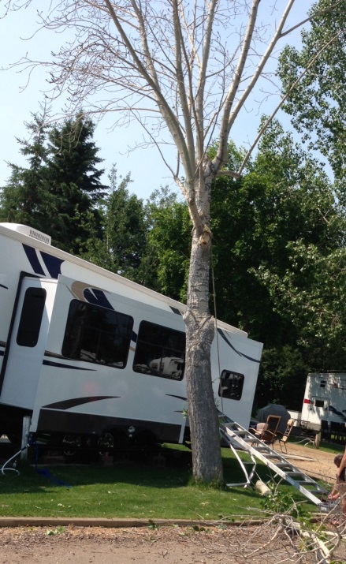
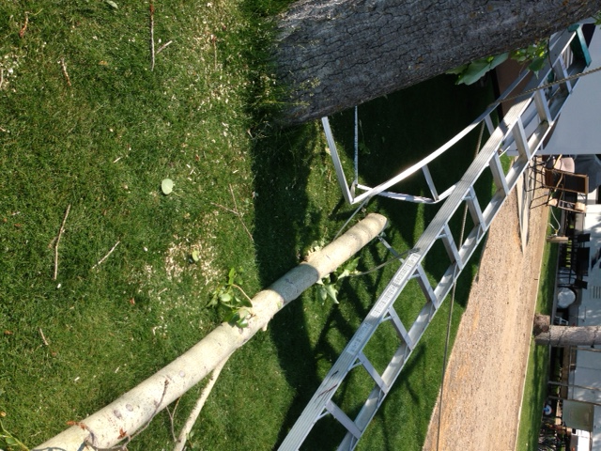
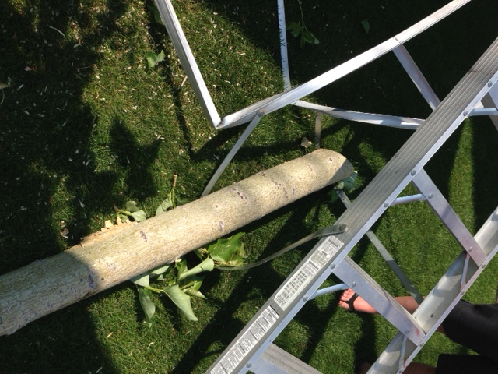
Safety Moment
The big question – Should I say something or not? I should have!

Slide 4
What is the Boiler and Pressure Vessel Technical Sub-Council?
Soon to be the “Pressure Equipment Technical Sub-Council
What is it?
http://www.safetycodes.ab.ca/Council/Pages/default.aspx
How does it work?

Slide 5
What is the Boiler and Pressure Vessel Technical Sub-Council?
Make-up of the Council?
What does it do for the members of GPAC?
I’d like know more about the Council and the regulatory framework

Slide 6
What is the Boiler and Pressure Vessel Technical Sub-Council?
Question about current regulations?
How do I raise an issue to the Council?

Slide 7
Hierarchy
Safety Codes Act
Pressure
Welders Regulation
Administrative
Items
Regulation
Power Engineers Regulation
Pressure Equipment Exemption Order
Pressure Equipment Safety Regulation
Adopted Codes and Standards
ABSA Policy Documents approved by the Administrator
Technical Publications
API, NB etc.
Notes:
This chart illustrates how the information is provided on a need to know basis
For example39(1) of the Act says that an owner etc must have a quality management system when required by This Act that meets the requirements of the regulations
The New Regulations covers requirements for quality management systems and the IMR further detail.
I has really made a difference at meetings with owners to be able to point to specific requirements in the Regs
Safety Codes Act – Owner must ensure that equipment complies
Regs specify more how

Slide 8
2014/2015 Business
There were 6 meetings held in 2014 with 2 meetings thus far in 2015.
http://www.safetycodes.ab.ca/Council/SubCouncils/Pages/BPVMinutes.aspx
Significant changes:
Chair position is now a 2 year term
Out-going Chair – Brian Lade was replaced by Izak Roux in April 2015

Slide 9
2014/2015 Business
There have been 4 working groups set up to address issues arising in the following categories:
  Pressure Welders Working Group
  Power Engineers Working Group
  PESR, Codes & Standards, Design Survey/Registration and New Equipment Inspection Working Group
  PESR – In-Service Inspections, Repairs & Alterations and PEIM Working Group

Slide 10
Power Engineers Regulation
  Fired Process Heater Operator ticket,
    Reduced Supervision Guideline AB-528
    Lakeland College offers an approved training course
    The working group is still working on equivalencies for existing certifications

Slide 11
Power Engineers Regulation
NPSAC is recommending to SOPEEC to Standardize rating system; possibly more Consistent but definitely not simpler.
Note: NPSAC = National Public Safety Advisory Committee of Canada)
SOPEEC = Standardization of Power Engineers Examination Committee

Slide 12
Power Engineers Regulation
Possible change to definition of boiler, focus more on original concepts – ie: managing stored energy in boilers
2014 November 6 Boiler Plant Risk Based Model (D0552733xAC51F).pptx
Note: any recommendations from either NPSAC or SOPEEC are still subject to approval through the Alberta legislation and Council processes

Slide 13
Pressure Welders
Introduction of “Tack Welders” Certificate to enable apprentice welders to gain experience on pressure piping fabrication
Welding Examiner in Training Certificate of Competency

Slide 14
Regulation/Code Updates
CSA B51 – new edition issued March 2014
Council looking at ways to adopt codes quicker
Potential new code specifically for Pressure Relief Devices Section XIII

Slide 15
Regulation/Code Updates
Movement of information from Section VIII Div 1 to Div 2 continues – creation of 2 Classes of vessels in Div 2: Class 1 will pertain to previous Div 1 vessels while Class 2 will pertain to previous Div 2 vessels
BPV NOV 2014.pdf (page 10)

Slide 16
Regulation/Code Updates
Methanol spheres installed on pipelines are now exempt from pressure equipment regulations
Canadian Propane Assoc has revised service intervals for Pressure Relief Valves:
10 years for > 2500 US gallons
25 years for =< 2500 US gallons

Slide 17
ABSA Updates
Dr K T Lau retired in Sept 2014, Mike Poehlmann became Chief Inspector and Administrator
Design Survey has made some changes to it’s management structure, Djordje Srnic moved to a Technical Advisor and Assistant Chief Inspector role, Po Fok became Design Survey Manager

Slide 18
ABSA Updates
ABSA Alerts and Bulletins can be found at:
  http://absa.ca/IBIndex/Default.aspx

Slide 19
ABSA (Alberta Boilers Safety Association) Updates
New Documents:
Engineered pressure enclosures – ABSA has held 2 meetings to discuss the new AB-500 series document
AB-506 was revised in 2014, Notable changes:
  Introduction of sample inspection for Exploration and Production equipment
  Modification to Quick Opening Closure vessel inspection requirements and intervals

Slide 20
ABSA (Alberta Boilers Safety Association) Updates
Policy change regarding; inspection, reporting and fee changes to previous NSAF vessels. Main justification was the perception that NSAF = NSI. Fees were charged at 25% for 2014, additional 25% in 2015, ‘16 & ’17
Note: NSAF = Not Subject to Annual Fees
  NSI = Not Subject to Inspection

Slide 21
Communication
How would this group like me to communicate go-forward
  Current meeting minutes on SCC website, is this sufficient?
  Any new issues this group would like to bring forward to BTC?

Slide 22
Communication
  Forum/process for bringing these to my attention for consideration of BTC?

Slide 23
Important Links
ABSA: www.absa.ca
Safety Codes Council: http://www.safetycodes.ab.ca/Pages/Home.aspx
American Petroleum Institute: http://www.api.org/
National Board: http://www.nationalboard.org/
Center for Chemical Process Safety:
http://www.aiche.org/ccps

